Slide 1
Illumination
GE 621
3DTV Graduate Course
November 8, 2026
Bülent Özgüç, Uğur Güdükbay
Courtesy of James Money, Anthony Steed

Slide 2
Ambient Lighting
Ambient lighting is diffuse non-directional source of light that occurs as a result of thousands of reflections on surfaces.
Given that the ambient component is constant for all objects, the surface of the object can reflect more or less ambient light depending on its surface.

Slide 3
Ambient Light
Approximation to global illumination
  Each object is illuminated to a certain extent by “stray” light
  Constant across a whole object
Often used simply to make sure everything is lit, just in case it isn’t struck by light direct from a light source

Slide 4
Ambient Lighting
Our equation for intensity of light is then
I=I_{a}k_{a}
k_{a} is the ambient reflection coefficient from 0..1 and describes a property of the material.
I_{a} is the amount of ambient light in the world.

Slide 5
Lighting Equation #1
But we use RGB so
I_{r, red} = k_{a,red}I_{a,red}
I_{r,green} = k_{a,green}I_{a,green}
I_{r,blue} = k_{a,blue}I_{a,blue}

Slide 6
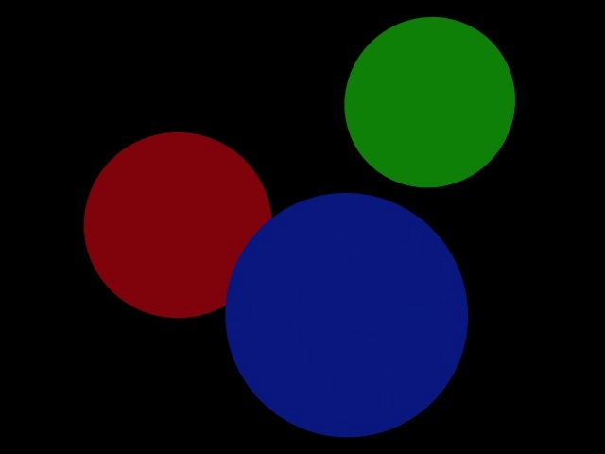
The Image - Ambient

Slide 7
Point light sources
Nor, we have a uniformly lit object, but we want variation in the light, and want to base this on what we normally see. A point light source, similar to a lamp, flashlight, etc. would be a good example to try to mimic.
Notes:
2

Slide 8
Diffuse Reflection
We now consider a point light source hitting on an object such as:
Point Light Source
N
L
Θ
Object
Notes:
3

Slide 9
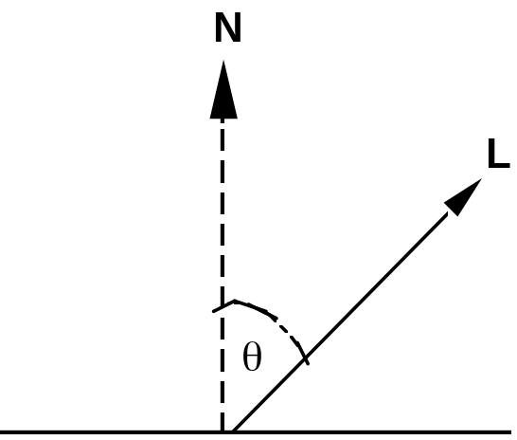
Lambert’s Law
Reflected intensity is proportional to cos Θ
L is the direction to the light
N is the surface normal

Slide 10
Diffuse Reflection
Now this surface will have a dull reflection known as Lambertian reflection or Diffuse Reflection.The amount of light reflected is proportional to the angle of incidence. The equation for such an item is:
I=I_{p}k_{d} cos(Θ)
I_{p} is the intensity of the point light source and K_{d} the diffuse reflection coefficient of the surface from 0..1.
Notes:
4

Slide 11
Diffuse Light
The normalised intensity of the light incident on the surface due to a ray from a light source
The light reflected due to Lambert’s law
The proportion of light reflected rather than absorbed (k_{d})

Slide 12
Diffuse Reflection
Now computing a cosine of angle is expensive for every point. However if vectors N and L are normalized (as one should do with them), we can rewrite the equation :
I=I_{p}k_{d}(N•L)
If N•L < 0 then the light is behind the surface and should not be included.
Notes:
8

Slide 13
Combining Ambient and Diffuse Reflection
We can combine ambient and diffuse reflection to give us a more accurate lighting model with:
I=I_{a}k_{a} + I_{p}k_{d}(N•L)
Notes:
12

Slide 14
Multiple Lights?
Add the diffuse terms
I_{i,j} is the incoming intensity of light j
l_{j} is the vector to light j
m
I_{r} = k_{a}I_{a} + Σk_{d}I_{i,j} (n.l _{j})
j =1

Slide 15
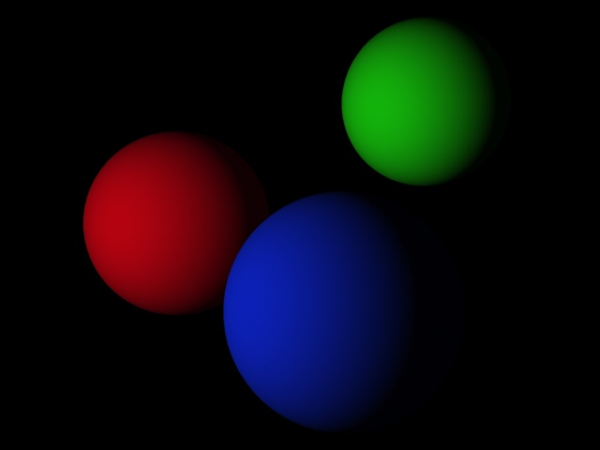
The Image - Diffuse

Slide 16
Light source attenuation
Now, if we have two object of the same material except one is 20 steps behind the other, they will be illuminated the same. We can resolve this problem with factoring in a drop in light level over distance.This is done by adding an attenuation factor:
I=I_{a}k_{a} + f_{att}I_{p}k_{d}(N•L)
Notes:
13

Slide 17
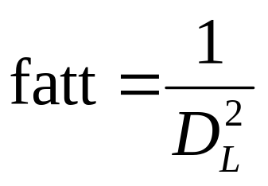
Light source attenuation
Now light source intensity would make sense to drop of at a square of the distance so:
However, this causes the light to fade too quickly or not slow enough.
Notes:
14

Slide 18
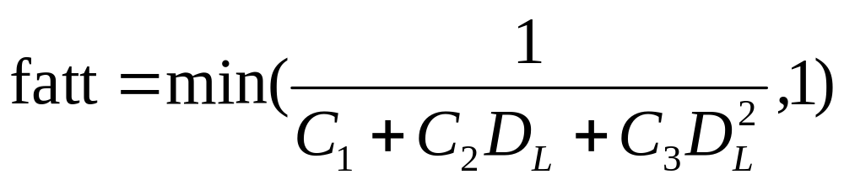
Light source attenuation
So, we change the equation to:
We want the value to be between 0..1 so, we clamp the upper range of f_{att} to 1.
Notes:
14

Slide 19
Colored Lighting
In the past we had assumed that our light intensity is a single color, i.e. I, monochrome.
In actuality, we want colored lights so we will change our equations so far slightly. We will represent our object’s diffuse color with one value of O_{d} for each color. In the RGB color model, (O_{dR},O_{dG},O_{dB}) triple represent’s the object’s diffuse RGB components.
Notes:
15

Slide 20
Colored Lighting
Also, the three primary illuminating light colors will also have to be changed to I_{pR}, I_{pG}, and I_{pB} which reflection in proportion to k_{d}O_{dR}, k_{d}O_{dG}, and k_{d}O_{dB}. Here is how the red component would look now:
I_{R}=I_{aR}k_{a}O_{dR} + f_{att}I_{pR}k_{d}O_{dR}(N•L)
Notes:
16

Slide 21
Colored Lighting
Now, we will have similar equation for green and blue. However, to simplify matters we will represent the three equation with a λ for the R, G, or B light value as such:
I_{λ} =I_{aλ}k_{a}O_{dλ} + f_{att}I_{pλ}k_{d}O_{dλ}(N•L)
In this case, there would be three equations, with R, G, or B substituted for λ in each.
Notes:
17

Slide 22
Specular Reflection
Specular reflection is the reflection you witness off of shiny surfaces, unlike the dull reflection off diffuse surfaces. The best example is that of a shiny fruit such as an apple. You will notice the light of the light reflected off the surface is not the color of the apple, but the color of the light.
Notes:
18

Slide 23
Specular Reflection
You also note the reflected light move as you move. The figure below illustrates specular reflection’s interaction of rays.
Light
N
L
R
Θ
Θ
α
V
Notes:
21

Slide 24
Specular Reflection
L is the Light’s Normal.
N is the Normal of the surface.
R is the reflection light ray.
V is the direction of the viewer.
Light
N
L
R
Θ
Θ
α
V
Notes:
1

Slide 25
Perfect Specularity
θ
θ
Would almost never see the specular highlight

Slide 26
Phong Illumination Model
Now Phong came up with a way to represent non-perfect reflectors such as an apple:
I_{λ} =I_{aλ}k_{a}O_{dλ} + f_{att}I_{pλ}[k_{d}O_{dλ}cos(Θ) + W(Θ) cos^{n}(α)]
This model allows for maximum reflection at α=0 and falls off sharply afterwards. This is accomplished by the term cos^{n}(α) where n is the specular-reflection coefficient of the object. n is 1 for gently falloff of light, and at infinity there is a focused reflected light. n typically varies from 1 to 200-300.
Notes:
2

Slide 27
Phong Illumination Model
I_{λ} =I_{aλ}k_{a}O_{dλ} + f_{att}I_{pλ}[k_{d}O_{dλ}cos(Θ) + W(Θ) cos^{n}(α)]
The amount of light that is reflected is Θ, then W(Θ) is the fraction of reflected light.
Now if R and V are normalized, cos(α)=R•V.
Also, if W(Θ) is assumed to be constant for an object, it is replaced by k_{s}, the specular reflection coefficient, ranging from 0..1.
Notes:
8

Slide 28
Phong Illumination Model
Thus, our rewritten equation is now:
I_{λ} =I_{aλ}k_{a}O_{dλ} + f_{att}I_{pλ}[k_{d}O_{dλ}(N•L) + k_{s}(R •V)^{n}]
Earlier, we had said the specular reflected color was independent of the color of the object, so we had better account for that:
I_{λ} =I_{aλ}k_{a}O_{dλ} + f_{att}I_{pλ}[k_{d}O_{dλ}(N•L) + k_{s}O_{sλ} (R •V)^{n}]
Where O_{sλ} is the specular reflection color for the object.
Notes:
9

Slide 29
Imperfect Specularity (Phong)
V is the direction to the eye
N is the normal
L is the direction to the light
H bisects V and L
N
V
H
L
surface

Slide 30
Specular Component
k_{s}I_{i} (H.N)^{n}
n is the power of the light
  High n implies smaller specular highlight
  Low n makes the highlight more blurred

Slide 31
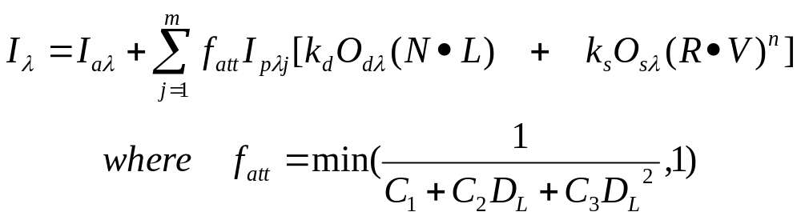
Multiple Light Sources
Now how many times have you entered a room illuminated by a single light bulb?
We need to account for multiple light sources, so for M light sources:
Note. Specular component can be substituted to be k_{s}O_{sλ} (H.N)^{n}
Notes:
10

Slide 32
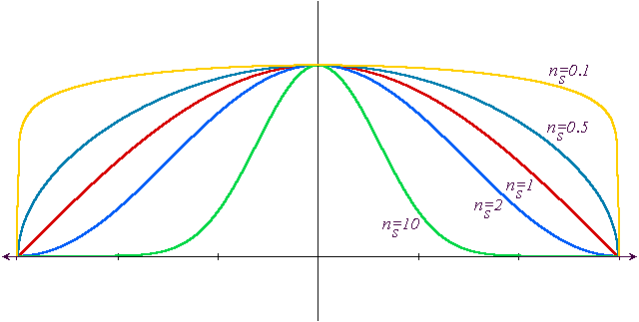

Slide 33
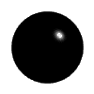







specular reflections as the direction of the light source and the
coefficient of shininess are varied.

Slide 34
Multiple Light Sources
There is one possibility now that I_{λ} will exceed the maximum value of a pixel, on Windows 95/NT, 255. The way we will resolve the problem is clamp the maximum of I_{λ} to 255.
Notes:
11

Slide 35

The Image - Specular

Slide 36
Constant Shading
Now how are we going to shade each polygon? Do we evaluate each pixel value separately?
Unfortunately, this is the correct way, but it would take too long to compute.
Our first approach is to find the pixel value for one vertex and use that for the entire polygon.
Notes:
12

Slide 37
Constant Shading
Believe it or not, constant shading is valid only if this is true:
  The light source is at infinity.
  The viewer is at infinity.
  The polygon represents the actual surface, and not an approximation to one.
If the first two are wrong, then we cannot use a single point on the polygon for constant shading.
Notes:
13

Slide 38
Interpolated Shading
Instead of flat shading, we could use interpolated shading. It works as such:
  We evaluate the illumination equations at each vertex(n times), using the same normal each time.
  Then, when we fill, we interpolate the I values along the edges in the 2D polygon filler, much as we have done Δx for each y increment to find scanline polygon edge intersections.
  We also increment by some change in I along x for each value of I.
Notes:
14

Slide 39
Interpolated Shading
So with each edge in our filler we have now:
  Ymin
  Ymax
  X - the X coordinate of point with Ymin
  1/m or the X increment
  Imin(RGB value)
  deltaI(RGB value)
Notes:
16

Slide 40
Interpolated Shading
Repeat until Y=max Y of polygon(or until AET and ET are empty).
  Move from ET to AET any edge whose Ymin=y.
  Remove from AET any edge whose entry has y=Ymax. Sort AET on increasing X.
  Fill in pixels using pairs of X coordinates on line y, starting with Imin pixel value on edge 1 incrementing by:
  (edge2->Imin-edge->Imin)/(edge2->x-edge->x)
  Increment y by 1.
  Add 1/m to x for each active edge.
  Add deltaI to Imin each active edge.
Notes:
17

Slide 41
Polygon Meshes and Shading
Remember our last assumption about flat shading:
The polygon represents the actual surface, and not an approximation to one.
If we have a mesh of polygons that are not actually a cube, etc., but is supposed to be curved, we need to determine the shade of polygon based on the surrounding polygons using either Gouraud or Phong Shading.
Notes:
18

Slide 42
Gouraud Shading
Gouraud shading eliminates discontinuities in intensity. It does it through the use of intensity interpolation shading, similar to the interpolated shading we discussed earlier. However, instead of using a polygon normal, we now will use a vertex normal for each point on the polygon.
Notes:
19

Slide 43
Gouraud Shading
This illustrates the concept of vertex normals:
Polygon 3 Normal
Vertex Normal
Polygon 1 Normal
Polygon 2 Normal
Notes:
1

Slide 44
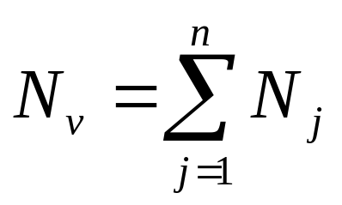
Gouraud Shading
To compute the vertex normal, we find all the normals of the polygons containing the vertex. Then :
Then, we should normalize the vector and compute D from the vertex point.
After this we proceed as normal in interpolated shading, but using vertex normals instead of polygon normals.
Notes:
2

Slide 45
Phong Shading
Phong Shading is the other form of interpolated shading for approximating curved surfaces. Instead of interpolating intensities, it interpolates the vertex normals. We can incrementally change the values of the A, B, C, D of the vertex normals, thus reducing the computational load of the algorithm.
Notes:
4

Slide 46
Phong Shading
However, since the normals are recomputed each time, the intensity equation must be reevaluated at each pixel. This reduces to our original shading idea, but with one limitation:
IT IS TOO SLOW FOR ANIMATION.
Hope lies in, however, OpenGL accelerator boards that perform Phong Shading in hardware.
Notes:
7

Slide 47




Slide 48
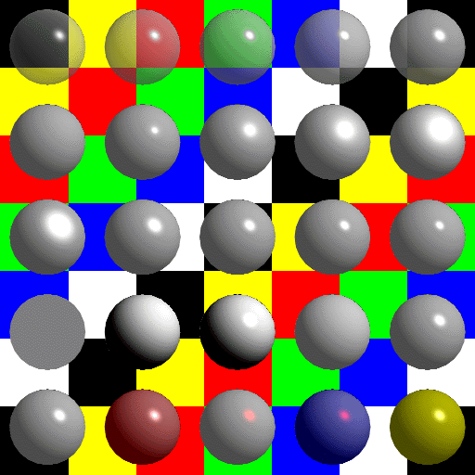

Slide 49
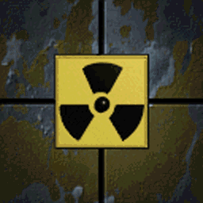
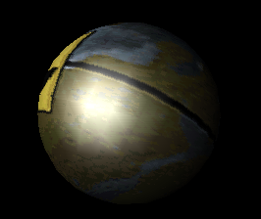
Texture Mapping
Texture Mapping is method of providing surface detail on a polygon, with relative little cost to the graphics system. It provide a way to map an image onto surface as shown:
Notes:
9

Slide 50
Texture Mapping
Texture mapping for general surfaces is not easy. It involves mapping the (x,y) of a pixel of an object to same point on the texture map, but in a (u,v) coordinate system. For polygons, we can map the square image to the polygon’s bounding rectangle:
Bounding Rectangle
Notes:
11

Slide 51
Texture Mapping
We can also allow for repeating images on a large polygon by specifying how large the texture map is in (U_{max},V_{max}) and repeating from 0 after (U_{max},V_{max}) is reached.
Notes:
12

Slide 52
Texture Mapping
We can add support for texture mapping in our polygon data structure by:
  Add an entry for an image pointer to U_{max}xV_{max} pixels.
  The value of U_{max} and V_{max} for this image.
  Specify what the (0,0), (U_{max},0), and (0,V_{max}) corners of the image map to on the polygon. i.e., give me three points bounding the image named tex1,tex2, and tex3.
Notes:
13

Slide 53
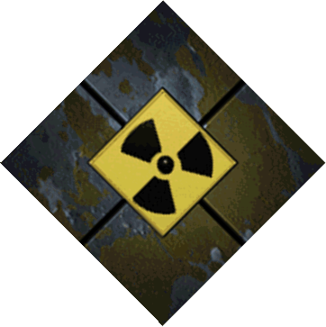
Texture Mapping
  Here is how the mapping looks:
Polygon
(0,V_{max})
(U_{max},0)
Tex3
Tex2
(0,0)
Texture Map
Tex1
Notes:
14

Slide 54
Texture Mapping
We can add support for texture mapping in our fill routine by:
  Project the 3 image points into 2D like a vertex of the polygon, except do not clip.
  Set the number of pixels in U_{scale} to distance from tex2(in 2d) to tex1(in 2d) and divide by U_{max}-U_{min}.
  Set the number of pixels in V_{scale} to distance from tex3(in 2d) to tex1(in 2d) and divide by V_{max}-V_{min}.
Notes:
15

Slide 55
Texture Mapping
  Set texture position (in floating point) to (0, 0).
  For each pixel draw:
    If U_{scale} or V_{scale} >1 average the points contained in Rect(texture.x, texture.y, texture.x+U_{scale}, texture.y+V_{scale}) for the pixel value. Otherwise, get the pixel at (texture.x, texture.y).
    Set texture position to (texture.x+U_{scale}*deltaX,texture.y+V_{scale}*deltaY);
    If texture.x>U_{max} set texture.x=0. Same if true for Y.(Even better if you set texture.x-=U_{max} and wrap around for averaging pixel values above).
Notes:
16

Slide 56
Back Face Culling
The idea behind back-face culling is to remove faces of an object that are obscured by other faces of the same object.
X
Gray polygons are back facing
Z

Slide 57
Back-Face Culling
It is easy to determine if a polygon is back facing: the Z component(C in Ax+By+Cz+D=0) is <0.
Some restrictions:
  The normals for all the faces must face outward for objects.
  Points in a polygon, thus must be created in a clockwise fashion.
This process typically halves the number of polygons, but not always.
All we need to do is add a Boolean Function for visibility to the Polygon3D object.

Slide 58
Visible Surface Determination
Now that you have reduced the number of polygons to draw, which ones are you actually seeing?
What about overlapping polygons???
The answer lies in algorithms called visible surface determiners.

Slide 59
Z-Buffer Algorithm
One of the most simple and most commonly used VSA’s is the Z-Buffer algorithm. It is an image precision algorithm.
It uses the frame buffer for the picture, but also a Z-Buffer, where instead of pixel values, it has the Z depth of the closest polygon.

Slide 60
void zBuffer(void){
int x,y;
double *zBuf
zBuf=new double[XMAX*YMAX];
for(y=0;y<YMAX;y++)
for(x=0;x<XMAX;x++){
SetPixel(hDC,x,y,RGB(0,0,0));//background
zBuf[y*XMAX,+x]=Z_{v.max}-Z_{v.min};//as far back //as we can go!
}
for(each polygon){
for(each pixel in polygon’s projection){
double pz=-[poly’s Z-value at (x,y)];
if (pz<=zBuf[y*XMAX+x]){
zBuf[y*XMAX+x]=pz;
SetPixel(hDC,x,y,PixelColor);
}
}
}
}

Slide 61
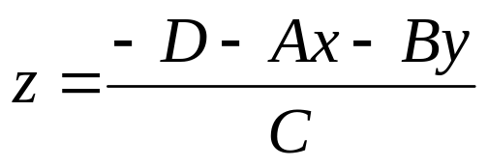
Determining Z
Remember for polygons we can get the normal from 3 points of the polygon:
    Ax+By+Cz+D=0
For our first point we find z by:

Slide 62
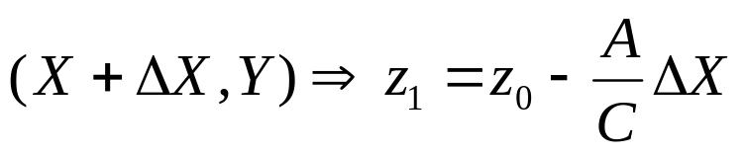
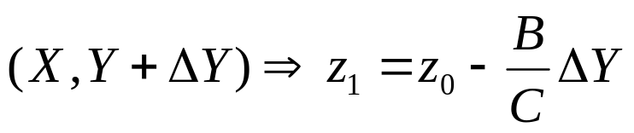
Determining Z
However, this is expensive to computer for every (x,y). We can do this by increments:
  At
  At
  If C=0 then use an average of Z at the vertices.

